Slide 1
West point workout app
CDT Joshua Cox
CDT Johnathan ellery

Slide 2
Description
Import tkinter, messagebox, math
Main function is to generate specific workouts tailored to each user’s goals
Equipment locator function

Slide 3
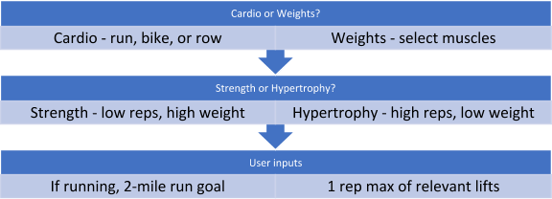
Flow chart
Workout Equipment Location

Slide 4
questionnaire
Google Form Questionnaire
n = 10
5 cows from A2 and 5 cows from C2
Questions:
What do you think ____ button does?
Does _____ seem like a useful feature?
Do you like the color scheme of the application?
Is the text easy to read and see?
Are there any features you think the application is missing?

